Slide 1
2020-21 END OF YEAR AWARDS

Slide 2
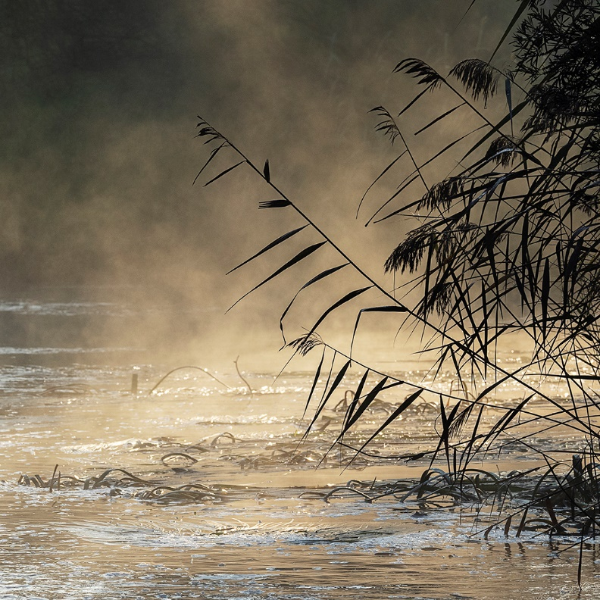
A GRADE
PRINT OF THE YEAR
“River Reeds And Fog” by Chris Reichl

Slide 3
B GRADE
PRINT OF THE YEAR
“Picked Parsley” by Mick Kupresanin

Slide 4
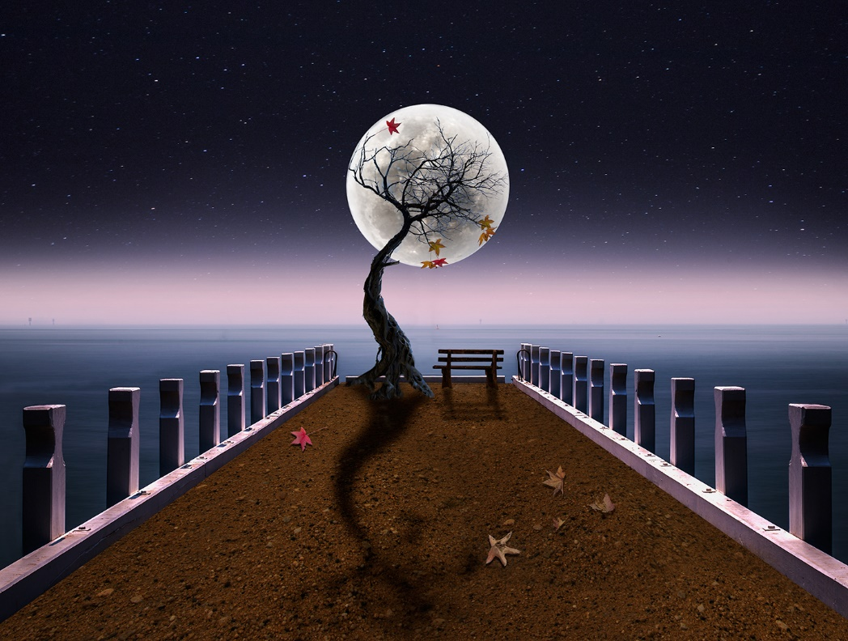
ALTERED REALITY
PRINT OF THE YEAR
“The Perfect Night” by Ketut Suwitra

Slide 5
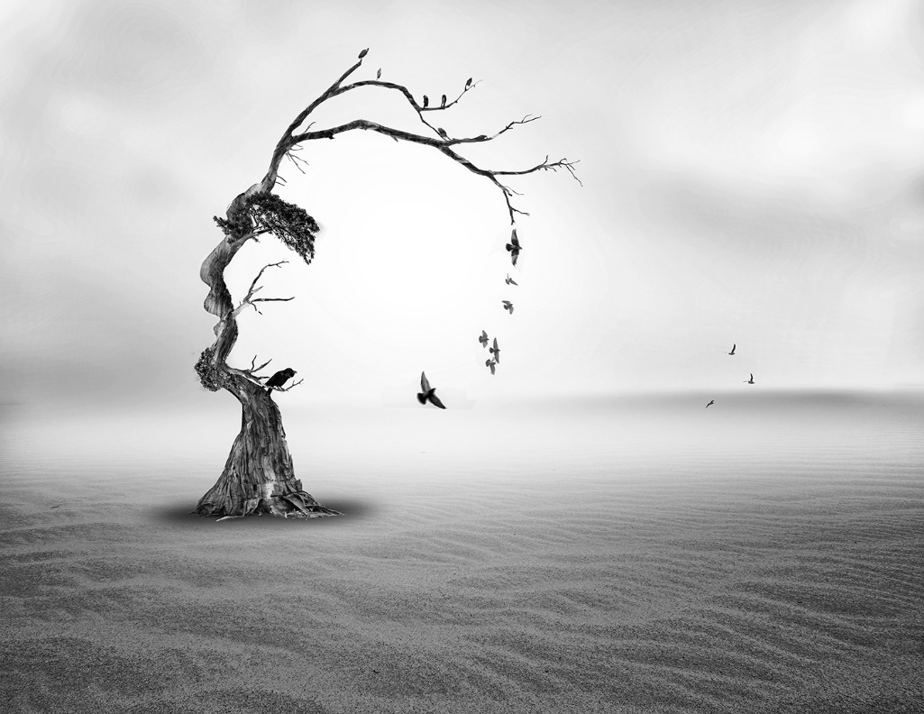
ALTERED REALITY
ELECTRONIC IMAGE OF THE YEAR
“Surviving the Desert” by Ketut Suwitra

Slide 6
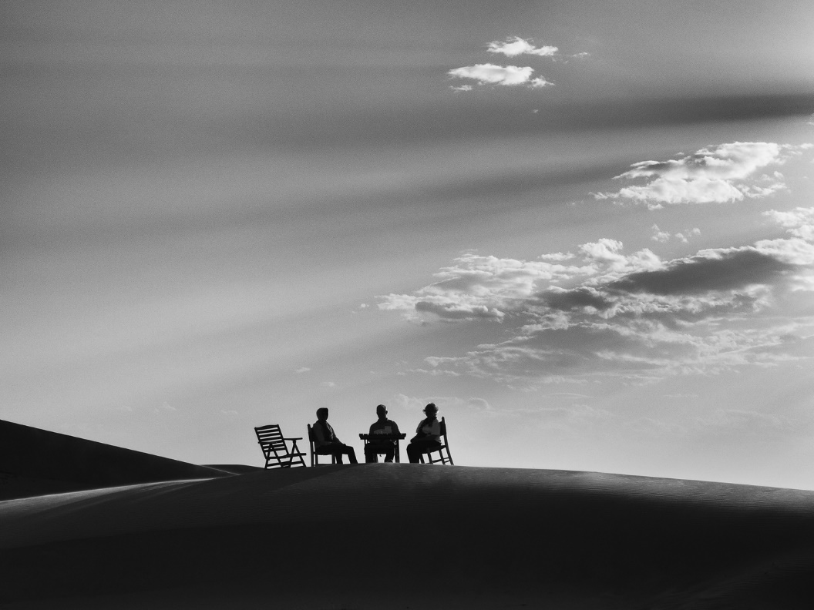
A GRADE
ELECTRONIC IMAGE OF THE YEAR
“Fetching The Drinks” by Terry Reichl

Slide 7
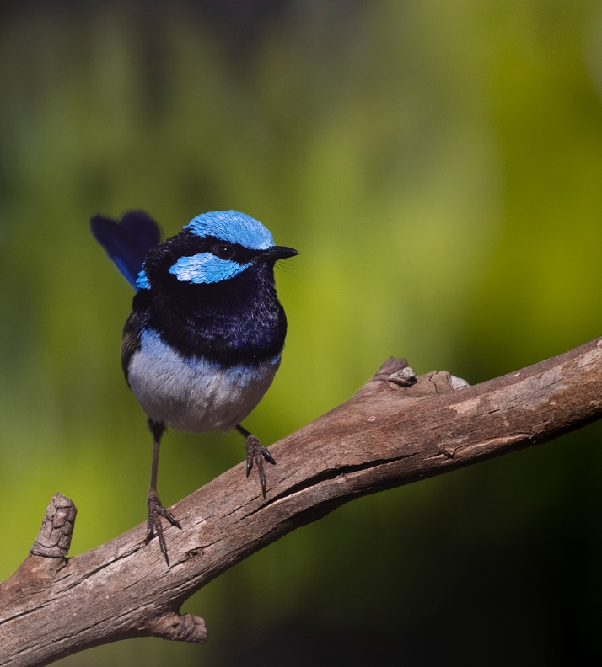
B GRADE
ELECTRONIC IMAGE OF THE YEAR
“Splendid In Blue” by Dee Kelly

Slide 8
PEOPLE PICTURE OF THE YEAR
EDI
“Fetching The Drinks” by Terry Reichl

Slide 9
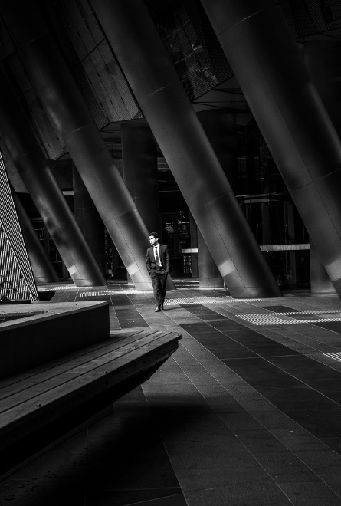
MONOCHROME PRINT OF THE YEAR
OPEN SUBJECT
“City Swagger” by Shelley McKiernan

Slide 10
COLOUR LANDSCAPE (inc. SEASCAPES)
PRINT OF THE YEAR
“River Reeds And Fog” by Chris Reichl

Slide 11
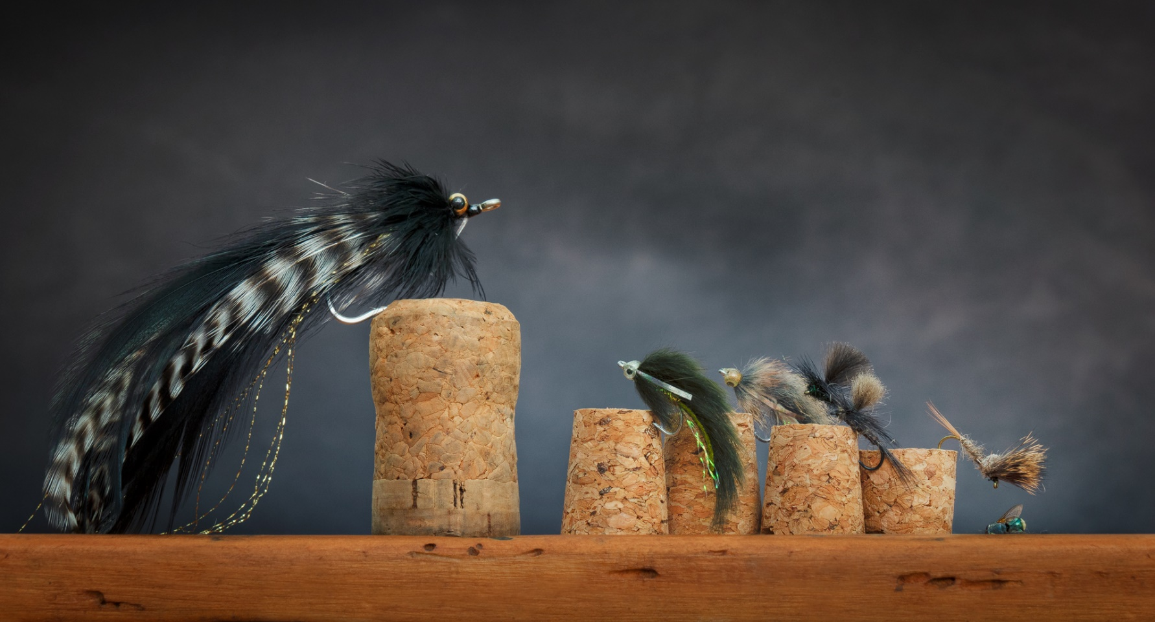
ROBB HOOPER MEMORIAL AWARD
For the Quirky, Humorous or Unusual
EDI
“The Classroom” by Sandy Mahon

Slide 12
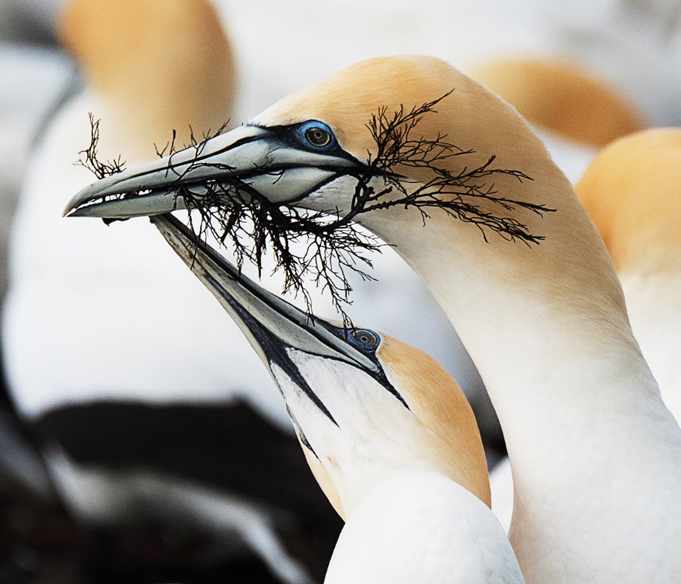
NATURE IMAGE OF THE YEAR
EDI
“Seaweed Gift” by Chris Reichl

Slide 13
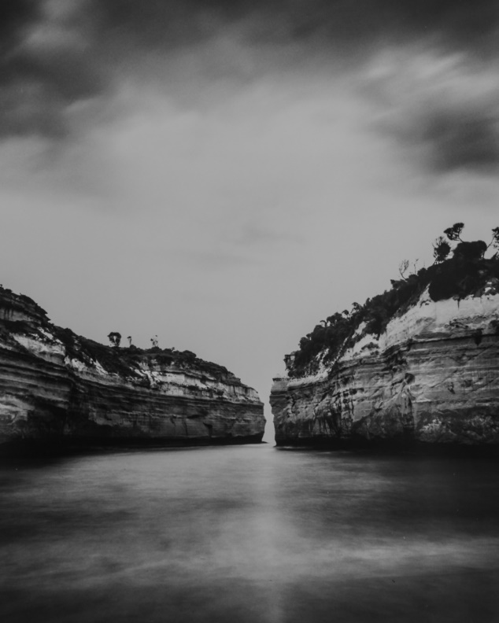
MONOCHROME LANDSCAPE
PRINT OF THE YEAR
(Self-Produced Darkroom Print)
“Loch Ard Gorge” by David Rendle

Slide 14
1st Place: Sandy Mahon
2nd Place: Chris Reichl
3rd Place: Ketut Suwitra
A GRADE AGGREGATE
PRINT PHOTOGRAPHER OF THE YEAR

Slide 15
1st Place: Dee Kelly
2nd Place: Brian Farey
3rd Place: Mick Kupresanin
B GRADE AGGREGATE
PRINT PHOTOGRAPHER OF THE YEAR

Slide 16
1st Place: Ketut Suwitra
2nd Place: Terry Reichl
3rd Place: Heather Prince
ALTERED REALITY AGGREGATE
PRINT PHOTOGRAPHER OF THE YEAR

Slide 17
1st Place: Terry Reichl
2nd Place: Sandy Mahon
3rd Place: Chris Reichl
A GRADE AGGREGATE
ELECTRONIC IMAGE
PHOTOGRAPHER OF THE YEAR

Slide 18
1st Place: Peter Roupas
2nd Place: Geoff Russell
3rd Place: Gerry Van der Meer
B GRADE AGGREGATE
ELECTRONIC IMAGE
PHOTOGRAPHER OF THE YEAR

Slide 19
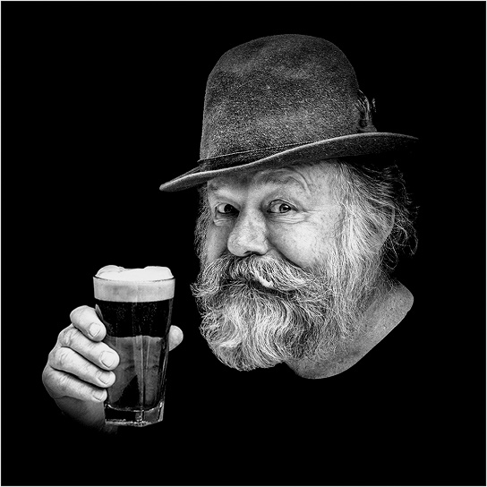
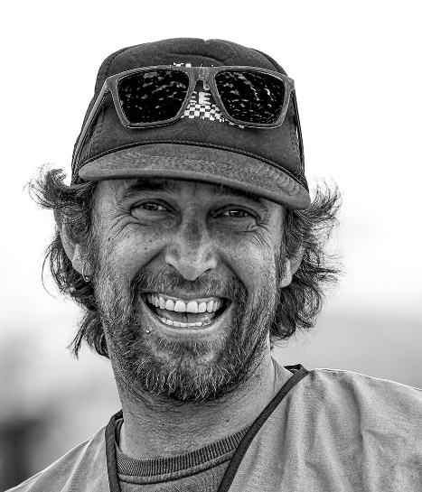
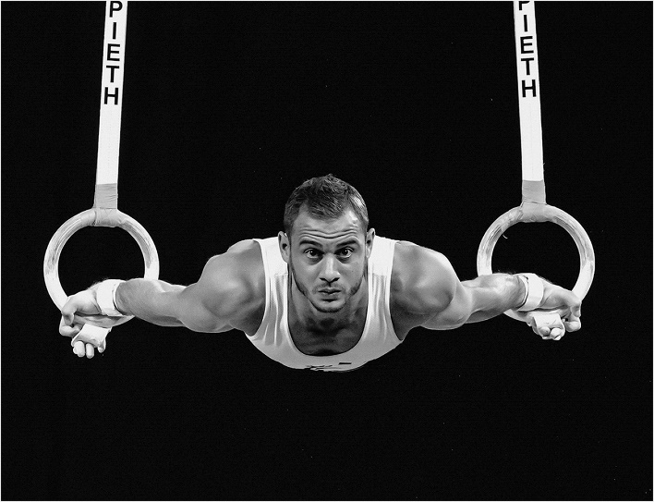
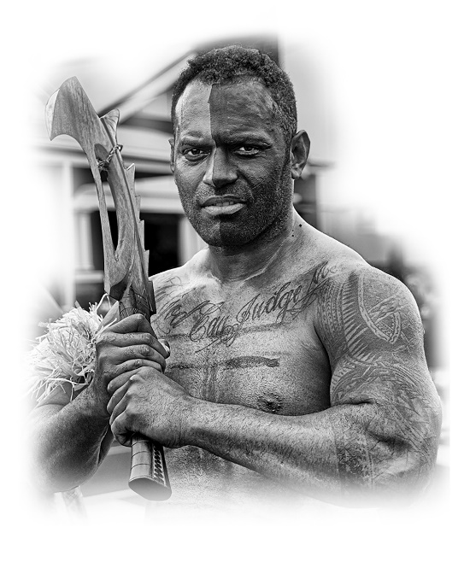
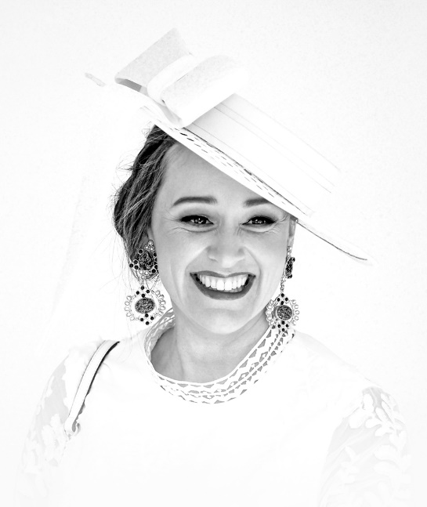
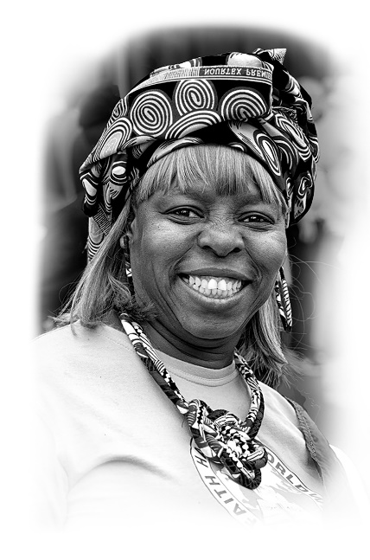
PRINT PORTFOLIO OF THE YEAR
Recipient: Frank Kennedy

Slide 20
ALTERED REALITY
PRINT PORTFOLIO OF THE YEAR
Recipient: Ketut Suwitra

Slide 21
ELECTRONIC IMAGE
PORTFOLIO OF THE YEAR
Recipient: Shelley McKiernan

Slide 22
MERITORIOUS EFFORT
IN BLACK & WHITE PRINTS
Recipient: Mick Kupresanin

Slide 23
MERITORIOUS EFFORT
IN COLOUR PRINTS
Recipient: Dee Kelly

Slide 24
MERITORIOUS EFFORT
IN EDI
Recipient: Judy Medwell

Slide 25
PARTICIPATION AWARD FOR 2nd YEAR MEMBER
Recipient: Geoff Russell

Slide 26
NICK MAJETIC “ENDEAVOUR AWARD”
Recipient: Heather Prince
Supported by David Rendle Speech

Slide 27
CLUBMANSHIP AWARD
Equal Recipient: Lyndall and Nick Abbott-Young

Slide 28
INDUCTEE INTO THE PERMANENT COLLECTION
Chris Reichl
David Grant

Slide 29
30 Years: Graham Mourney
15 Years: Matt Armitstea
10 Years: Lauren Holmes
Mich Kupresanin
Sandra McArthur
Janet Rogerson
Michelle Stokie
Gerry Van Der Meer
YEAR BARS

Slide 30
IN APPRECIATION
Gerry Van Der Meer for making the timber Club trophies

